Slide 1
Implemented Features
Cameras: pinhole, thinlens
Shapes: sphere, plane, triangle, trimesh
Lighting: pointlight, arealight, blinn-phong, texture mapping, reflections, refraction
Optimizations: Bounding Volume Hierarchy

Slide 2
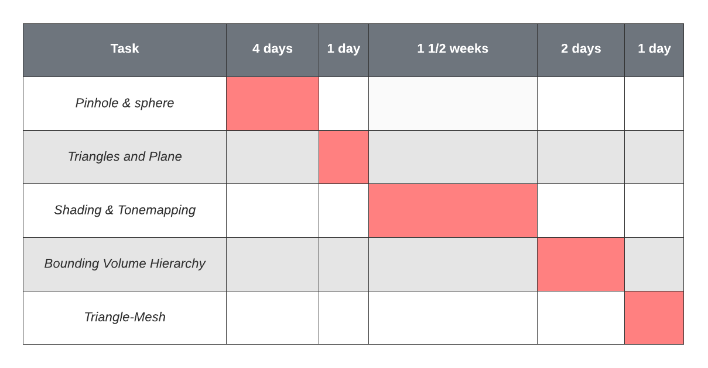
Time Breakdown

Slide 3
Things Learnt
Learnt the vector equations for reflection and refraction
Learnt about how to texture map and correctly shade a 3d model using barycentric coordinates
Learnt how to apply actually apply mote carlo integration in the context of rendering
Learnt (but didn’t implement due to time constraints) about using different colour spaces for tonemapping

Slide 4
Good and Bad
Good:
I appreciated that this gave us a chance to apply mathematical and algorithmic knowledge to produce the raytracer
Bad:
The size and structure of the coursework left me (and most others) completely lost as to how to start.
The mark distribution made it such that implementing a full raytracer only awarded 30% of the marks, when the documentation said that achieving such a thing was impressive.

Slide 5
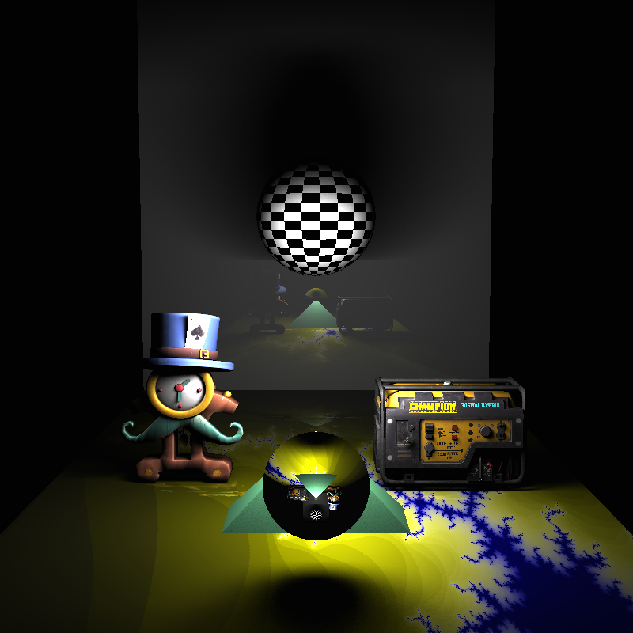
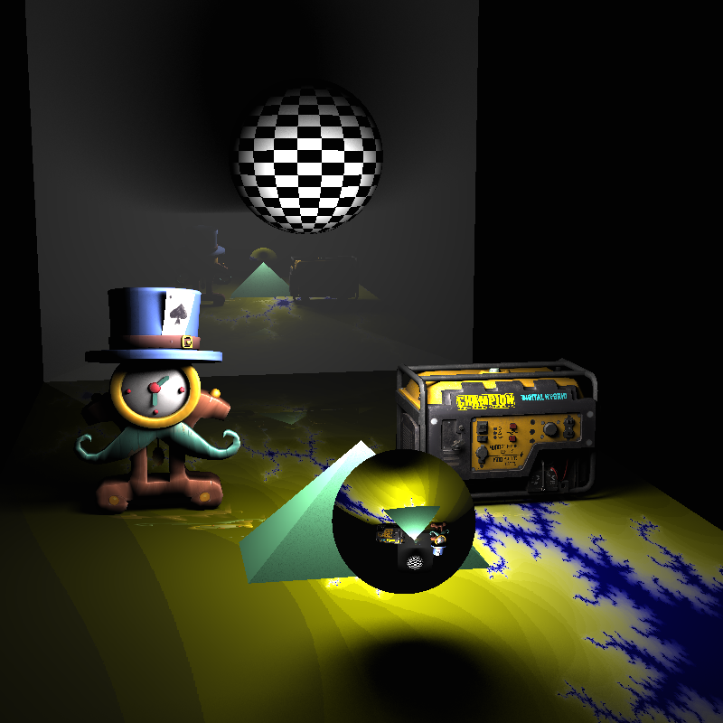
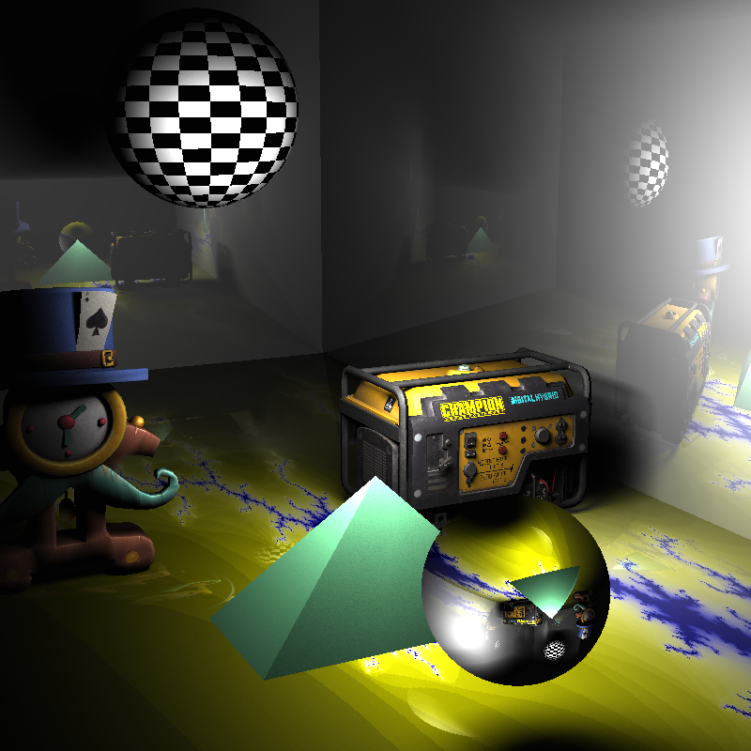
Rendered Images

